Slide 1
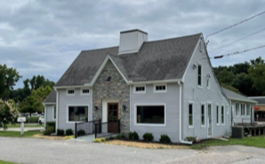
$470,000 First Mortgage Loan
Participations
7 7 Kent Road, New Milford, CT
3,134 SF Prime Office Space
Four Arrow Funding Inc.
Issuer
Prepaid Interest for Six (6) Months
1345 Avenue of the Americas, New York NY 10105

Slide 2
Executive
Summary
Overview. Four Arrow Funding Inc. (the “Lender”) is providing a $470,000 16% first mortgage loan (the “Loan”) secured by the 3,134 SF office property at 7 Kent Road, New Milford CT (the “Property”) to an entity formed by Thomas Maira (the “Borrower”) .
The Borrower. Thomas Maira has acquired several small office buildings on major highways in Connecticut to lease to small local users seeking non-family home office space near their homes. This strategy has leased up his small office buildings so far.
The Property. The Property is located at the traffic light connecting Route 7, Route 202, and Bridge Street, and directly in front of the Big Y Shopping center in New Milford. Great access to New Milford, Litchfield County, Brookfield, and Danbury.
Thomas is an attorney working at DLA Piper. Thomas is one of the attorneys that the Lender uses for their legal work. The likelihood of default is very low resulting from the relationship. The Lender is secured at approximately 75.0% Loan to costs.
Zoned B-1 allows for many retail and service-based uses. The Property is served by city sewer and water and has 2 driveway cuts directly on Kent Road.
The Property is 3,134 SF situated on just under an acre
of land.
Loan Term. The gross funded amount of the Loan is $470,000 less closing costs and interest reserve. The Loan term is one (1) year with the right to extend for six (6) months for a fee of $15,000. The is a first mortgage loan so the risk of principal loss is reduced.
The Property has been recently renovated with all new electrical, plumbing, HVAC, siding, and a new front door, while the roof is only a few years old.
The interior fit-out is unfinished but set up
for use as a salon/spa with plenty of
plumbing and small rooms for spa
treatments.
Participations. The Loan is divided into three (3) tranches and seven (7) units. The Senior A has three (3) units priced at $100,000 per unit paying 14.0% per annum prepaid for six (6) months with an effective annual yield of 15.5%. The Senior B has two (2) units priced at $50,000 per unit paying 17.45% per annum prepaid for six (6) months with an effective annual yield of 19.125%. The Junior C has two (2) units priced at $35,000 per unit paying 12.5% per annum prepaid for six (6) months with an effective annual yield of 25.35%. The Lender will buy one Junior C unit.

Slide 3
Capital
Structure
Each Senior A unit costs $93,000 for a face amount of $100,000.
Each Senior B unit costs $45,638 for face amount of $50,000.
Each Junior C unit costs $31,063 for a face amount of $35,000.
The yields are shown to the right.
The interest is prepaid for six (6) months if the Loan is not extended then current payments will be made.

Slide 4
Five Year
Projections
The five- year projections show a refinancing in Year 2 with the valuation and the equity value growing each year.

Slide 5
Closing Statement
The closing statement shows that even though the first mortgage is $470,000 and 85% loan to costs, the Borrower has to invest over $130,000 of cash to close the Loan. Thus, the actual Loan size is 75,72% Loan To Costs So, the Borrower has real “skin in the game”.
The investors receive 100% of the interest and the Lender receives the UW fee and Closing Fee. Chesterfield is buying one of the Junior C units showing his confidence in full repayment.

Slide 6
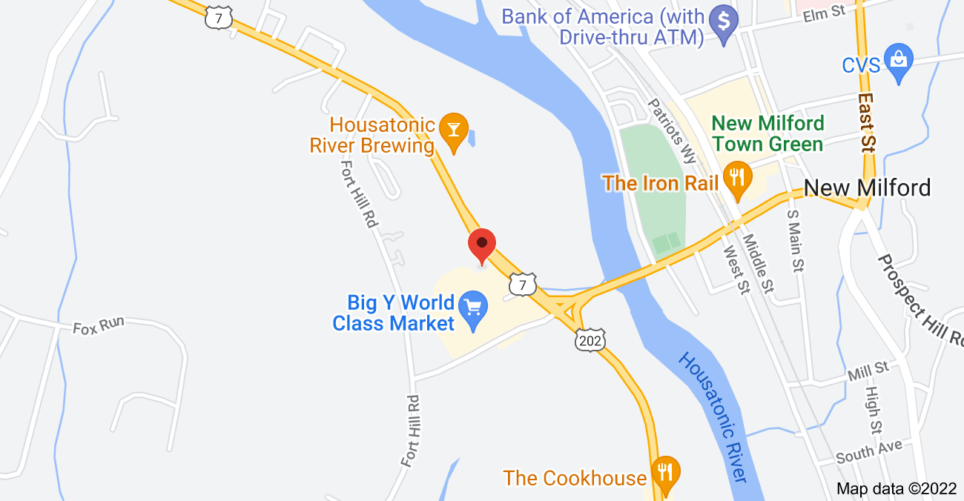
Demos

Slide 7
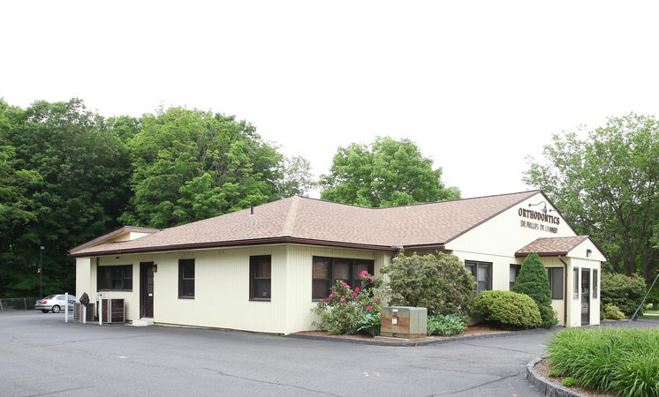
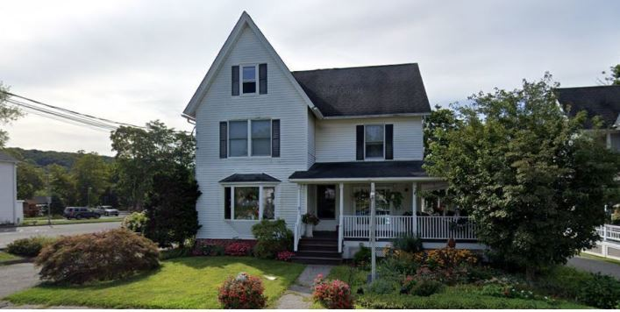
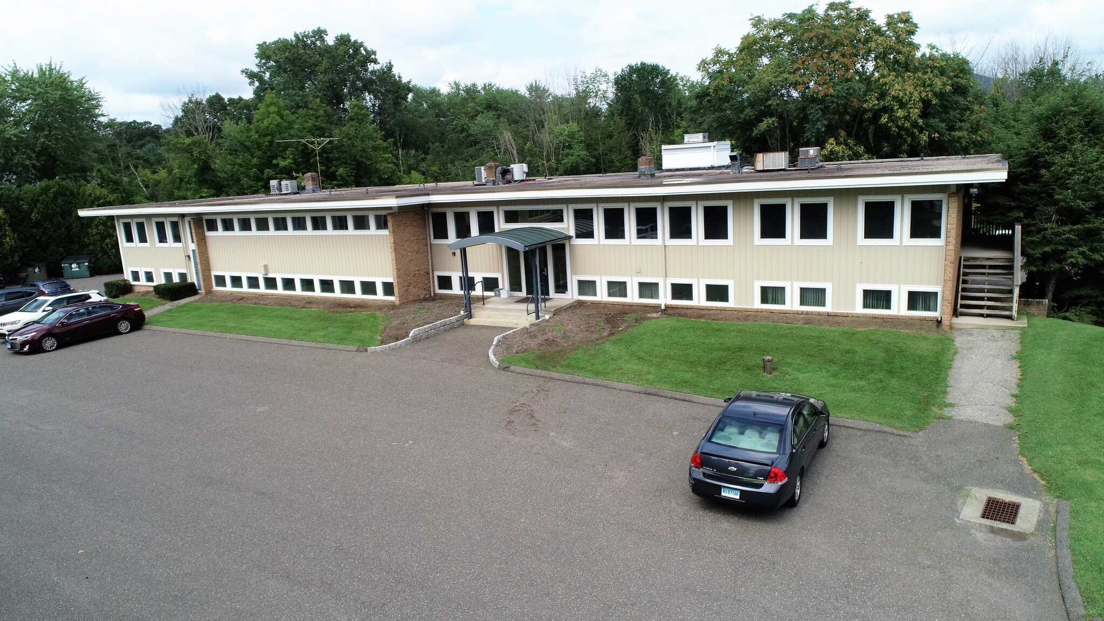
Comps
SF: 3,854
Price $695,000
Use: Medical
SF: 5,184
Rent: $40 PSF
Use: Medical
SF: 14,007
Rent: $46 PSF
Use: Medical

Slide 8
Floor
Plans

Slide 9
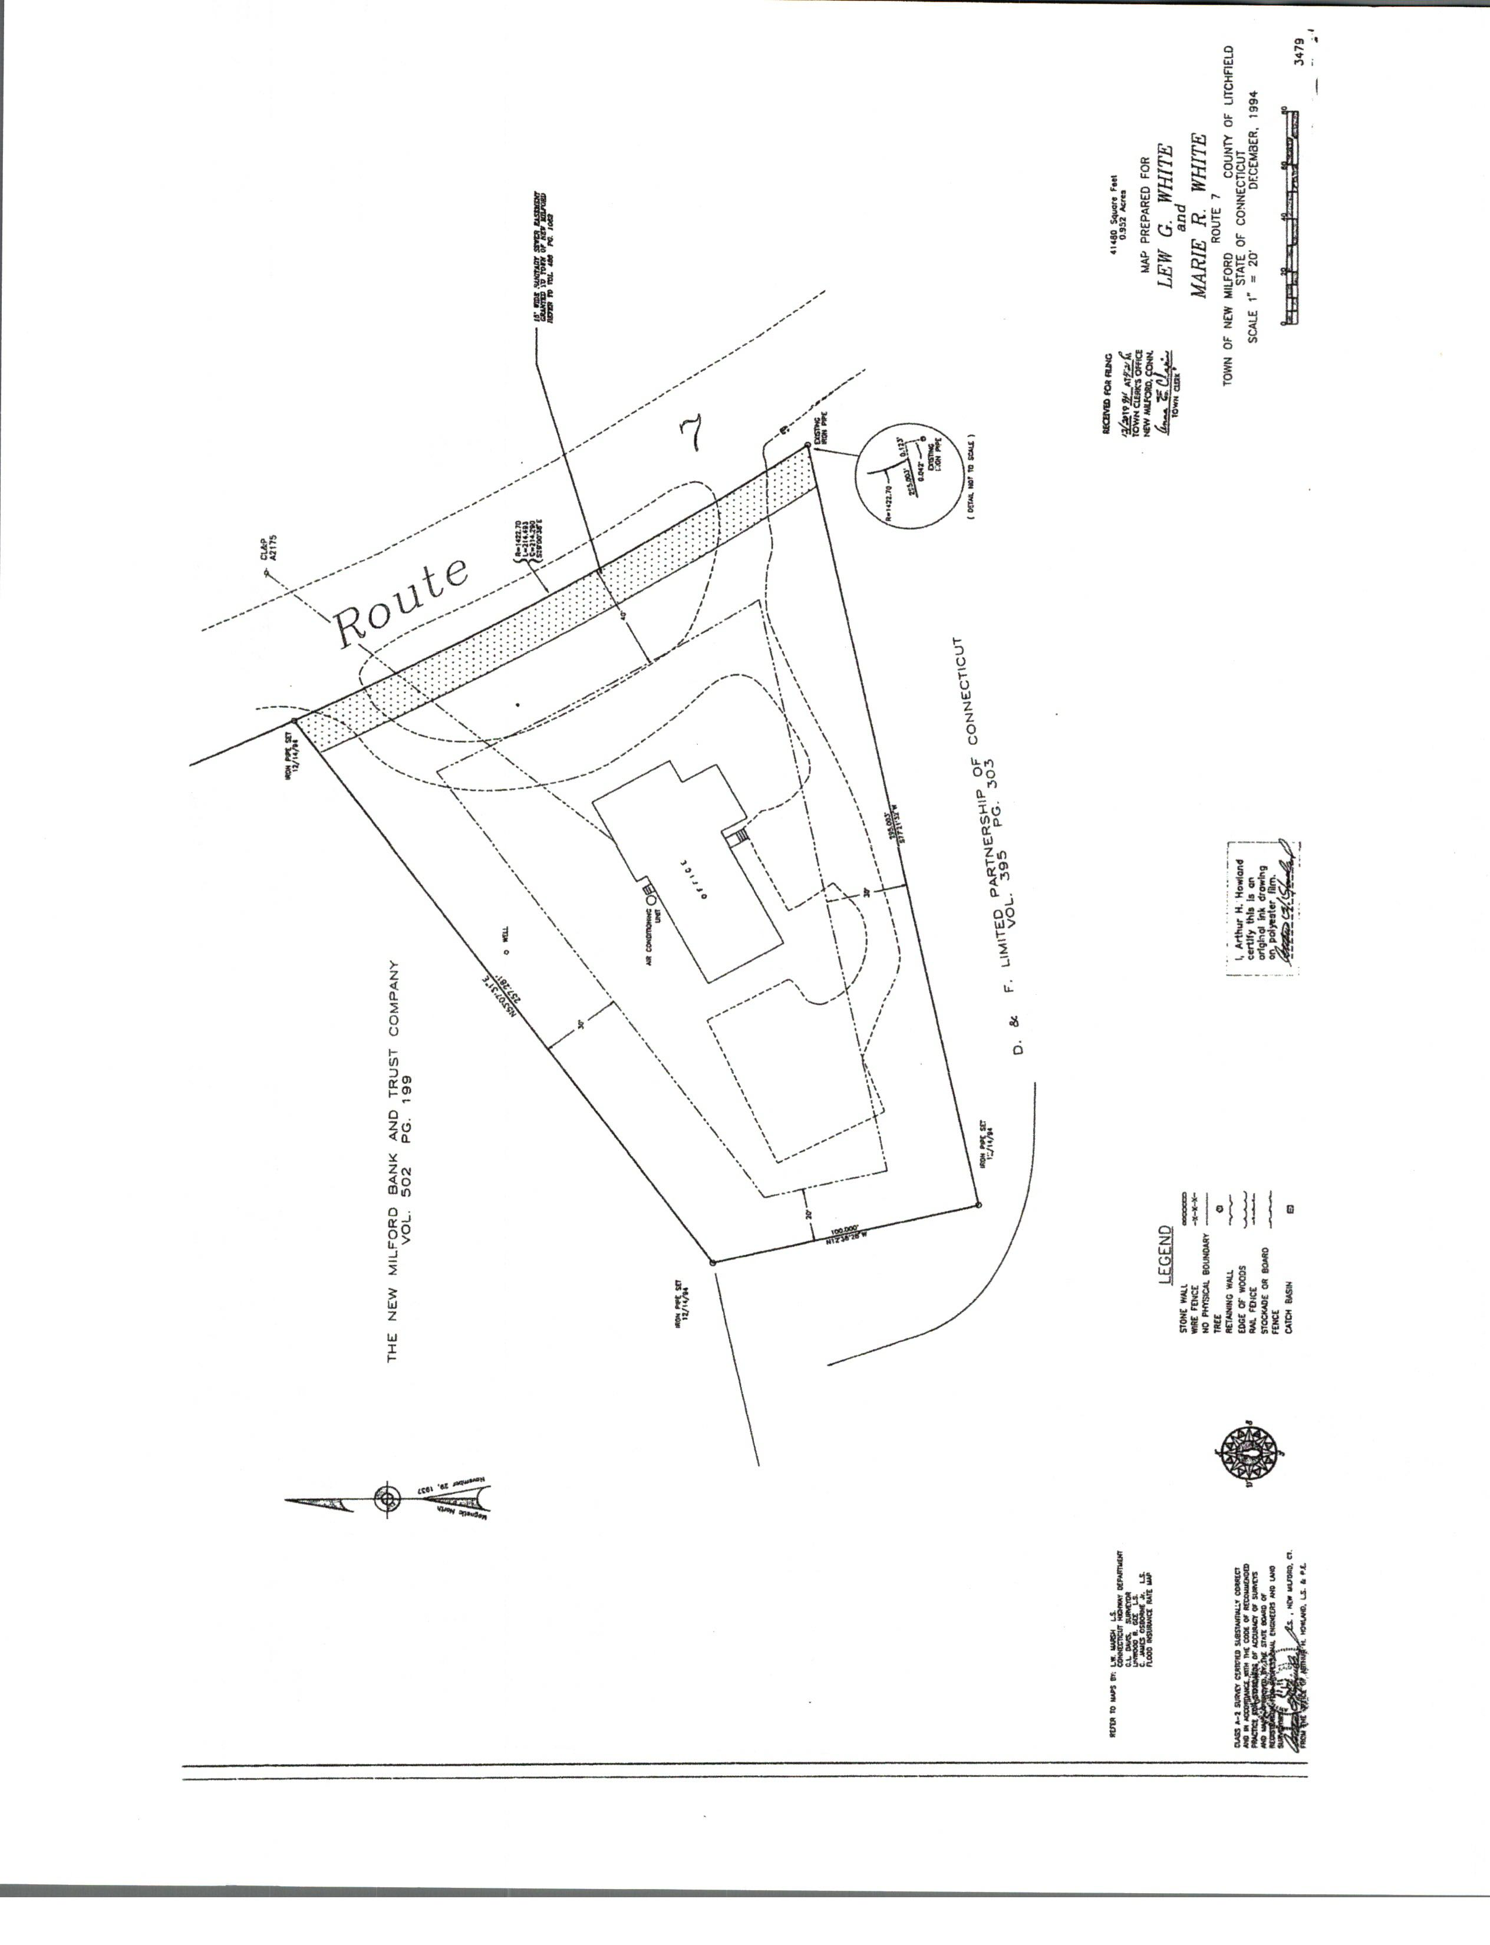
Site
Plan

